Slide 1
Hareton.
Ruined.

Slide 2
“His had first-rate qualities, and they are lost, rendered worse than unveiling.” (Bronte 211)
In this quote Heathcliff is comparing his son, Linton, to Hindley’s son, Hareton. He describes how Linton is worthless but he is making him look as good as possible, like shining tin and using it in place of silver. Heathcliff then goes on to explain how he took Hareton, who had so much potential to be something great, and completely ruined his chances; like using gold to make paving-stones. It is clearly seen that in his relationship with Heathcliff, Hareton was ruined.

Slide 3
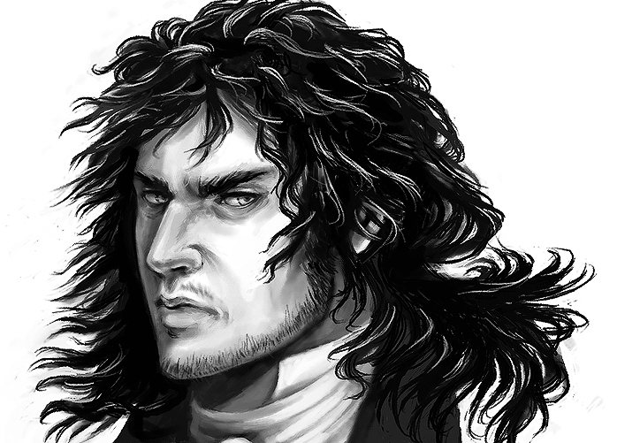
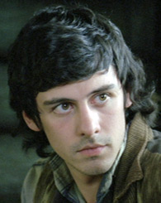
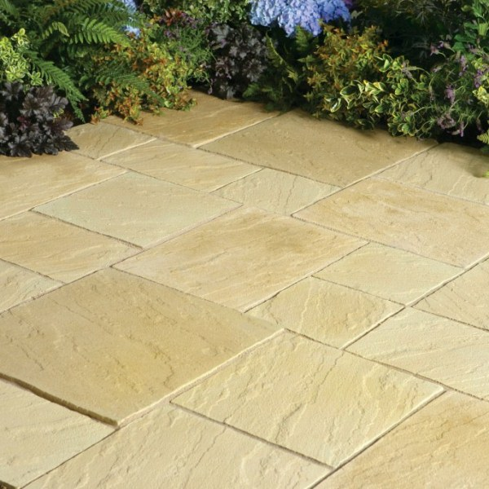
These pictures demonstrate the connection between Hareton and Heathcliff by relating how Hareton is like gold and Heathcliff used him like paving-stones. This use of descriptive writing beautifully illustrates the effect Heathcliff has on Hareton by showing he has gold like qualities and they are being ignored and neglected.

