Slide 1
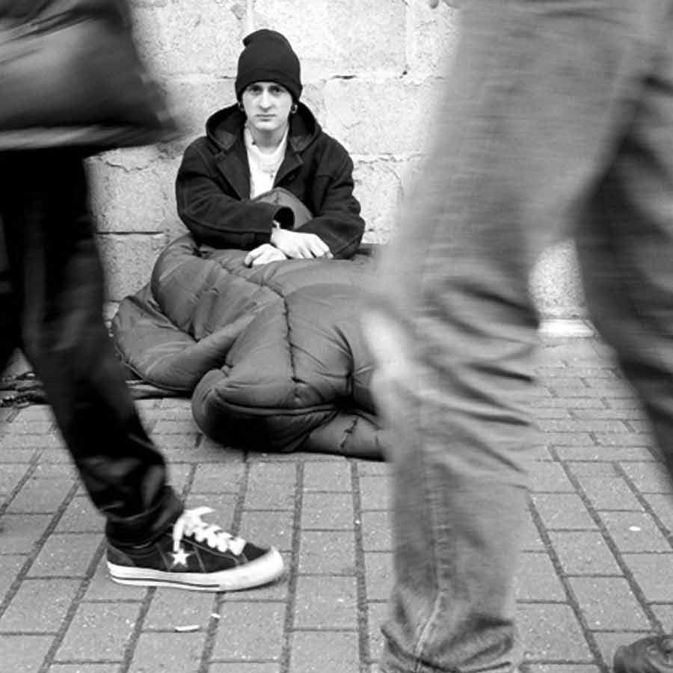
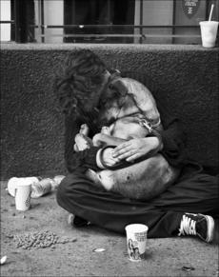
Article 22:
“Everyone, as a member of society, has the right to social security…”
What does it mean?
social security provides assistance for those unable to work due to sickness, disability, employment injury, unemployment or old age
What if it is violated?
If one unable to work due to an injury received while working, or due to a physical or mental disability, etc, they would have no source of income. If they did not have the right to social security, they would have no means of life. They would have no way to buy shelter or food and water, the basic necessities of life.

